Slide 1
Full Depth Reclaimation
Ranjeet Singh, Btech Civil Engineering

Slide 2
ABSTRACT:
Full Depth Reclaimation (FDR) is used for pavement. It is a technique in which various materials are mixed with soil to improve some properties of soil. This process is called stabilization.
In FDR, full flexible pavement sections and predetermined portion of the underlying materials are uniformly pulverised and blended together to produce homogeneous base course.
FDR has various advantages like lowers the cost , it is eco friendly, reduces time consumption, and various additional benefits. FDR can extend the life of road for upto 25 years.
Keywords:
pavement, stabilization, pulverised, homogeneous, predetermined

Slide 3
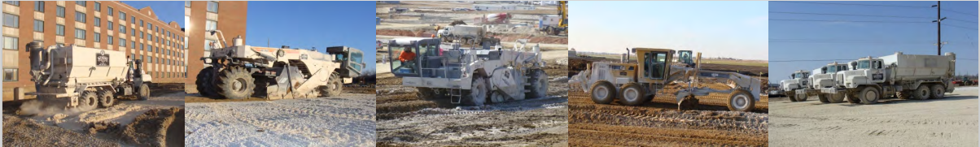
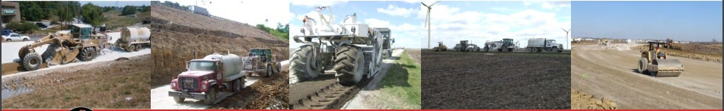
Full Depth Reclamation

Slide 4
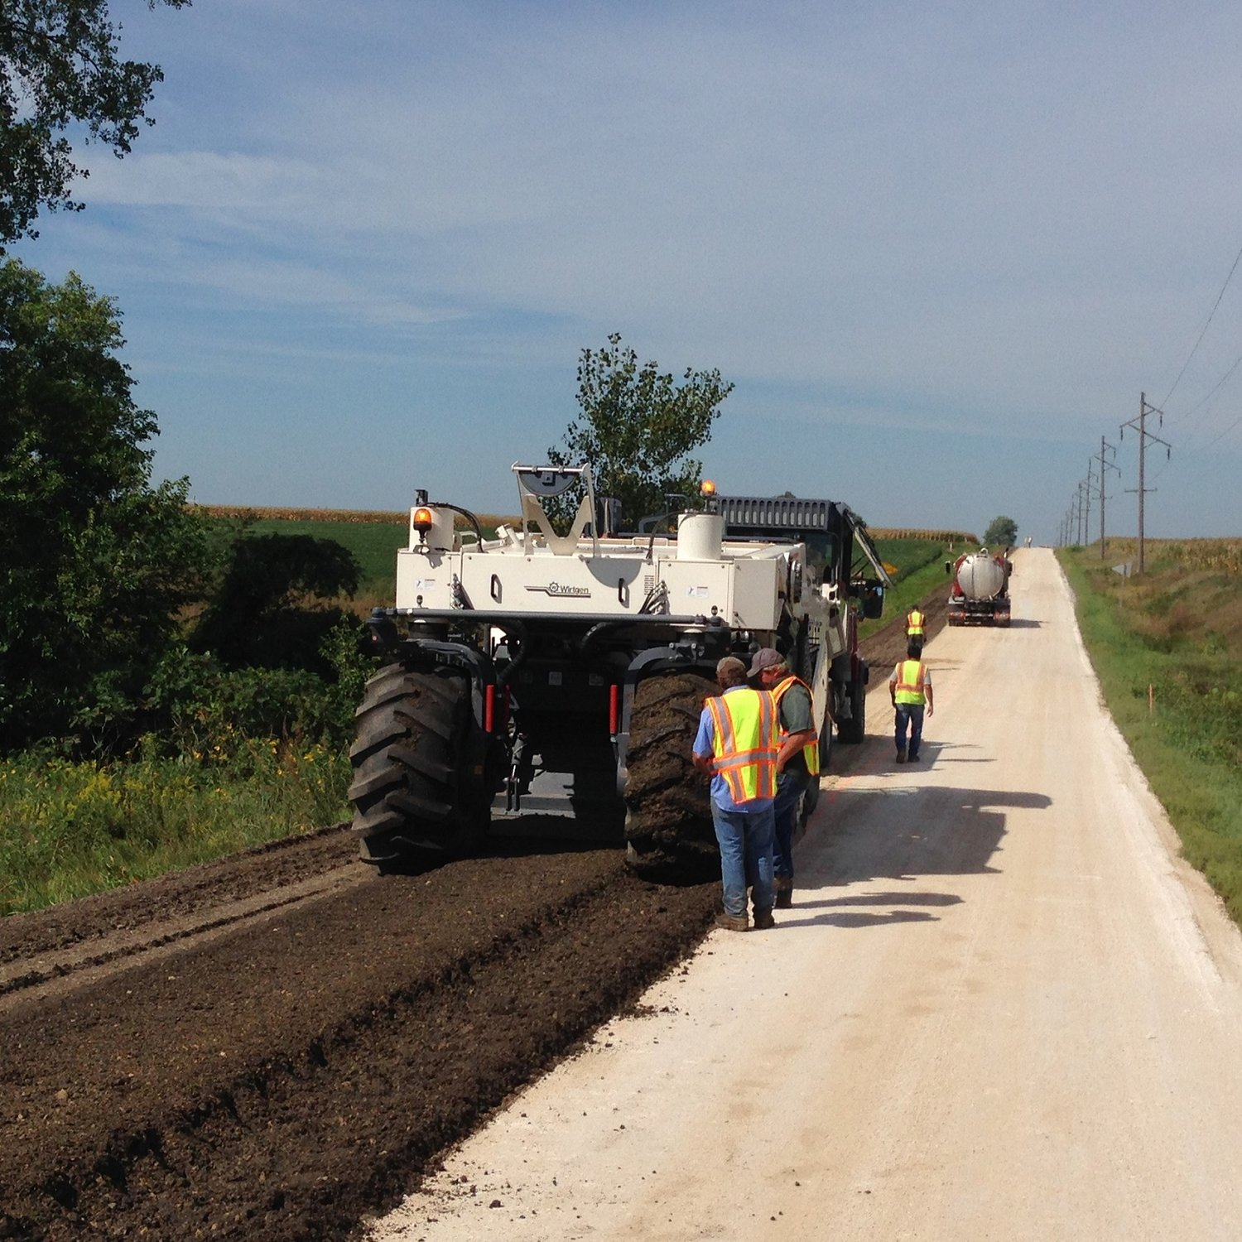
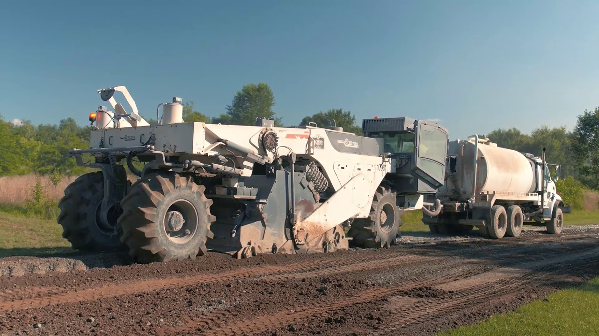
A View of FDR Machine

Slide 5
What is Full Depth Reclamation ?
Full depth reclamation (FDR) is an efficient means of rehabilitating the pavements.
A pavement rehabilitation is a technique in which the full flexible pavement section and a predetermined portion of the underlying materials are uniformly crushed, pulverized or blended, resulting in a stabilized base course.

Slide 6
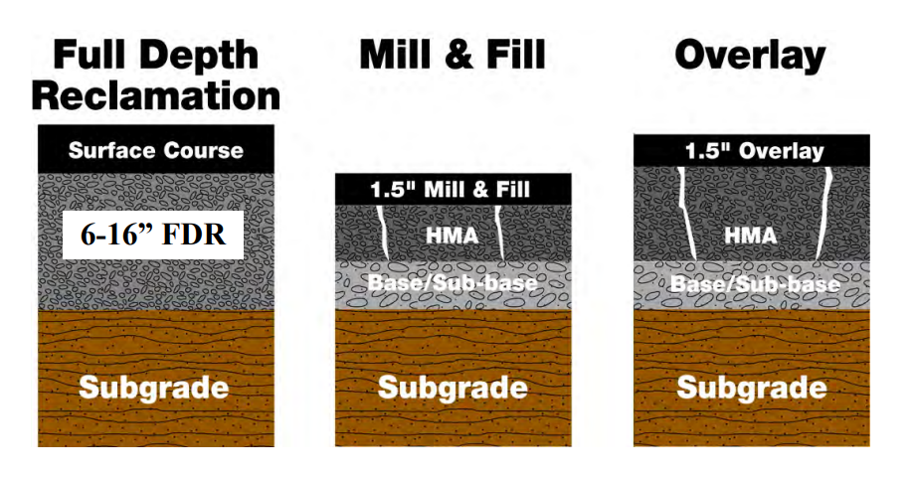
Advantages of Full Depth Reclamation
Saves time
Saves money
FDR may be the greenest construction process available.
FDR is more reliable process and the roads life may be upto 25 years.

Slide 7

FDR Candidates:
1. Parking Lots
2. Low Volume, Secondary Roads
3. City streets and Medium Volume Roadways
4. Interstate Highways
5. Private and regional airports

Slide 8
FDR Requirements
1. Reclaimer/ Estabilizer
Reclaimer / Stabilizer is designed for full-depth reclamation and soil stabilization projects.

Slide 9
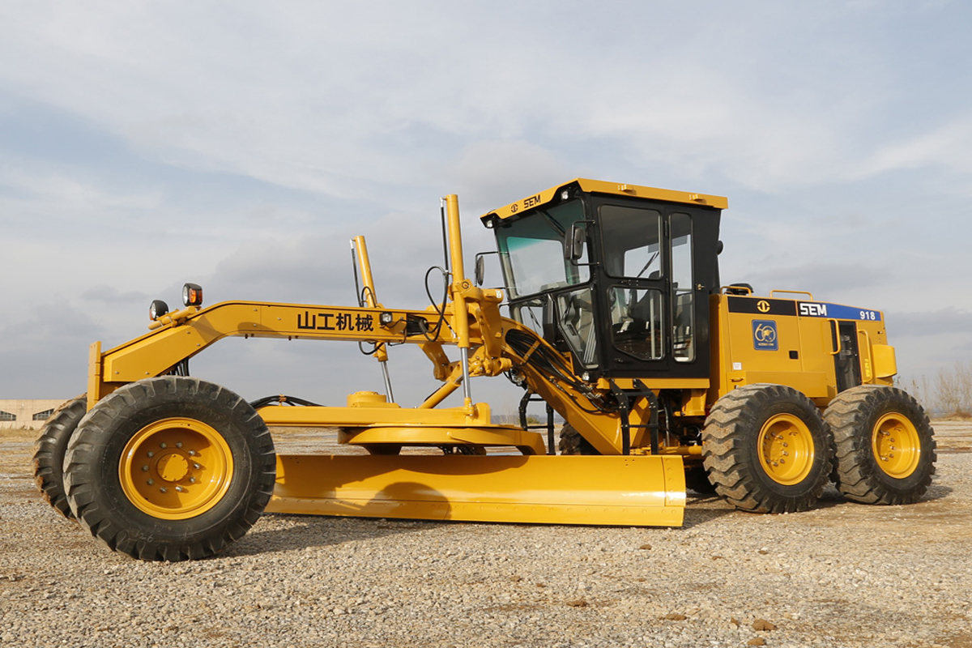
2. Motor Grader:
A motor grader, sometimes called a grader or road grader, is a narrow multipurpose construction machine used to flatten a surface during grading projects.

Slide 10
3. Compactors:
1. Vibratory Pad Foot
2. Pneumatic
3. Vibratory or static smooth drum

Slide 11
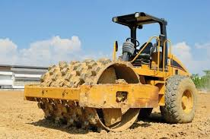
i. Vibratory Pad Foot
A Vibratory roller is a compactor having a drum used to densify soil, asphalt or other materials through the application of combined static and dynamic forces to increase the load-bearing capacity of the surface.
Vibratory rollers can fully cover the area underneath the wheel.

Slide 12
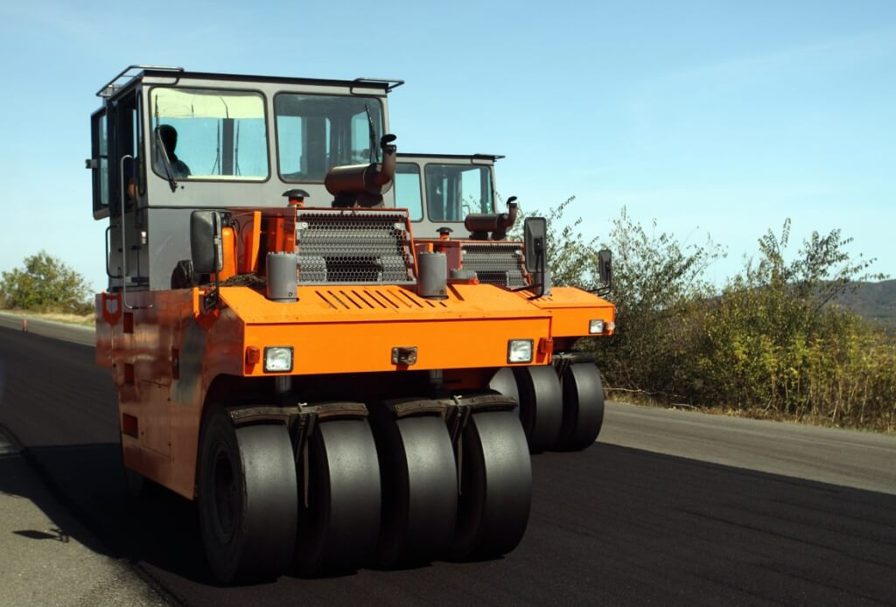
ii. Pneumatic
The pneumatic tire roller is a self-propelled compaction device that uses pneumatic tires to compact the underlying HMA.

Slide 13
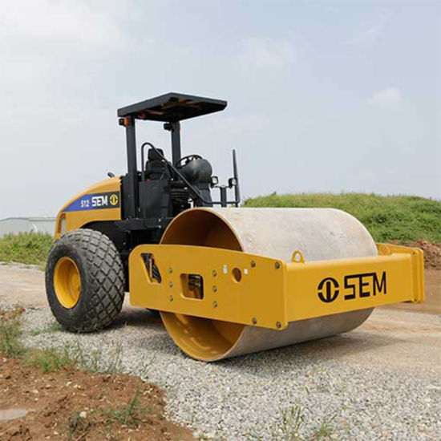
iii. Vibratory or Static Drum:
Static rollers lack a hydraulic system and vibratory-inducing mechanisms, where they instead gain their compacting capability from raw weight and the practice of oscillation, with the use of hexpad, sheepsfoot or tamper-type drum wheels.

Slide 14
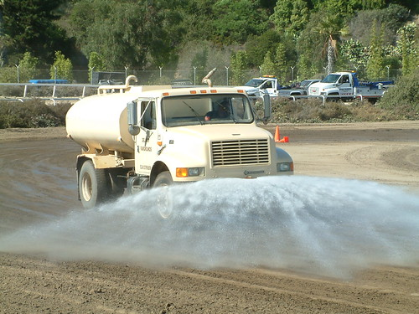
4. Water Truck:
A Water Truck is truck designed to collect and then spray water.
Water trucks are used in road and other civil construction to suppress dust and/or ensure that the rock or soil being worked by other machinery is at the required moisture content.
This Photo by Unknown Author is licensed under CC BY-SA

Slide 15
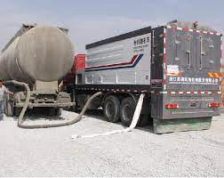
5. Cement Spreader
This binding agent spreader is used to spread cement for cold recycling roads and spread stabilized soil adhesives for roadbeds. These spreading vehicles can also be used to spread cement, lime powder, fly ash and other materials.

Slide 16
Chemicals Used:
Portland cement, lime and Type C fly ash have been used successfully as recycling additives.
Cement and lime have been used very successfully in combination with asphalt emulsions.
Solution used in this technology by machine is prepared by (Terrasil+Zycobond+Water)
Cement bitumen emulsion mortars are prepared by cement, bitumen emulsion, water, fine aggregate, and admixtures.

Slide 17
Conditions for better performance:
40-45% soil is must.
55-60 % aggregate required
100 ml of chemical needed per (meter)³
Moisture content ( optimised + natural ) should be 9% only.

Slide 18
First Pilot Project Using FDR Technology In Uttar Pradesh:
The first pilot project using FDR technology was done at Chitrakut and Prayagraj.
This project was completed by: Blacklead Infratech Pvt.Ltd
A very special thanks to Sr. Er. of this project Mr. Yogesh Kumar Singh who helped me at every step in gathering informarmation and completing the presentation.

Slide 19
Conclusions:
FDR is a process whose time has come it is ecofriendly,
gives enhanced performance and saves a lot money.
Conserves energy: since it is a cold process
Conserves material: stones and asphalts are reused
Long term cost effective: the cause of pavement failure is weak bases is addressed
Future maintenance costs are drastically reduced

Slide 20

Thank You Everyone

